Slide 1


EDUCATION WEB APPLICATION
EDUBRIDGE
CAPSTONE PROJECT PRESENTATION
SESSION 2022-2023
JAVA FULL STACK WEB DEVELOPMENT
TOPIC: FULL STACK WEB APPLICATION
Guide : ROHIT
SUBMITTED BY: SHREYANS JAIN
Batch number: 2022-8381

Slide 2
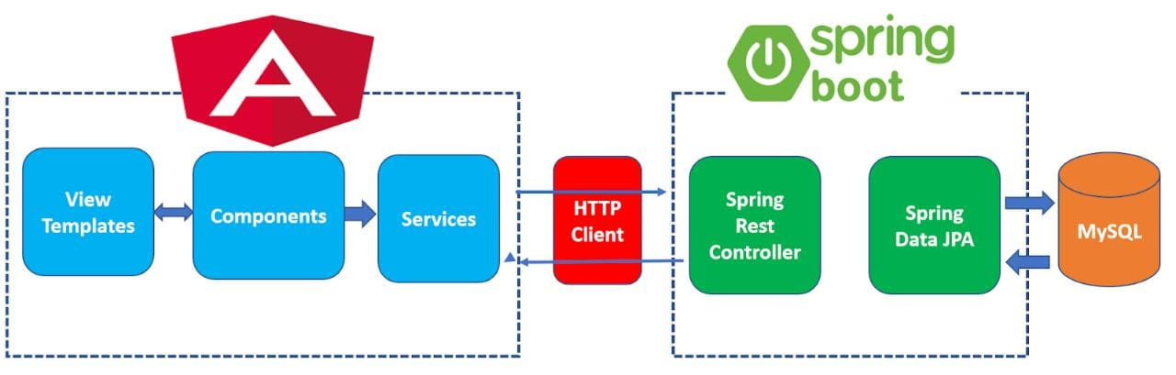
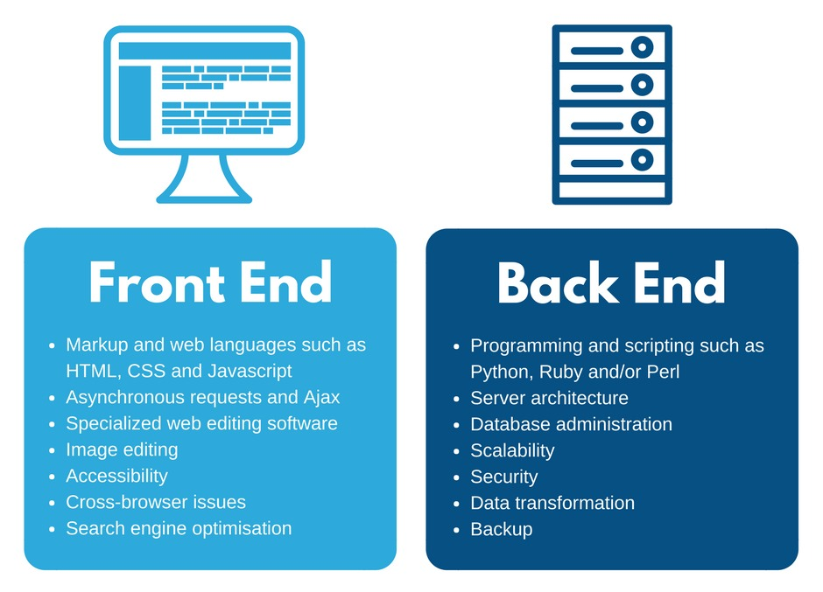

Slide 3

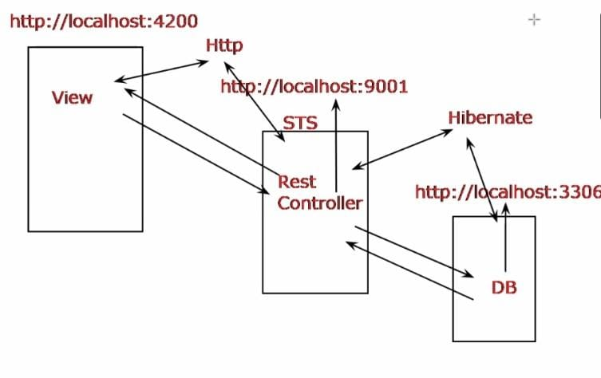









FRONTEND bACKEND

Slide 4
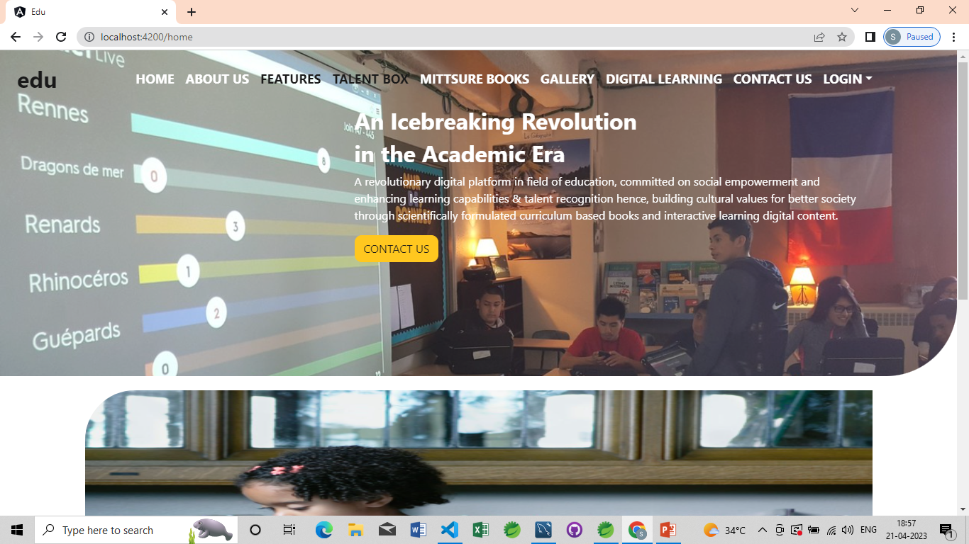
Lending Page of App

Slide 5
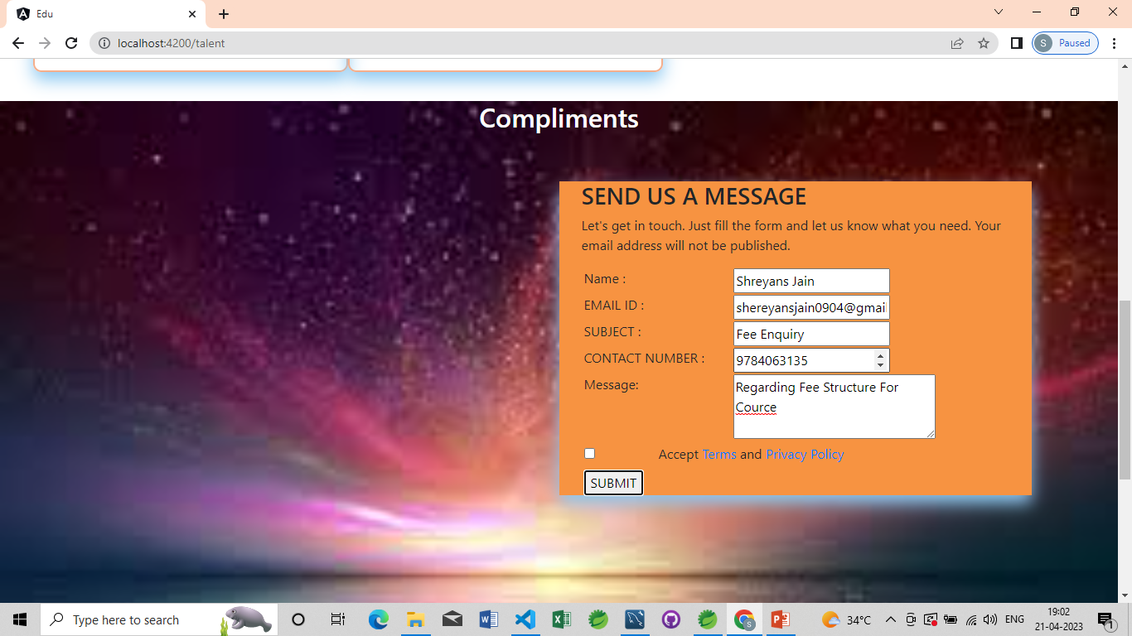
Contact Form

Slide 6
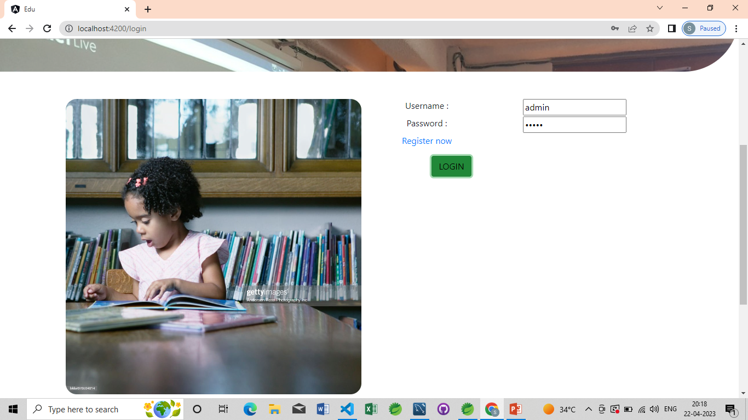
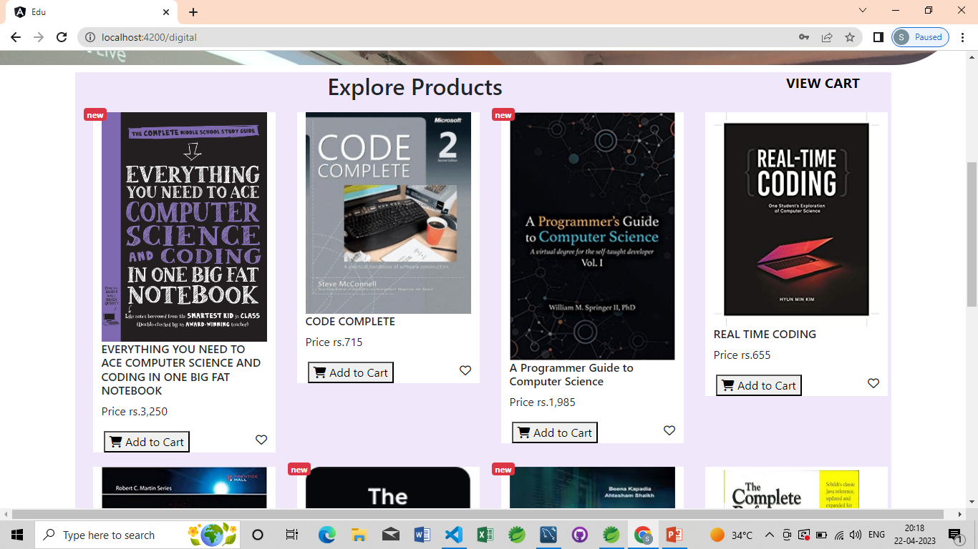
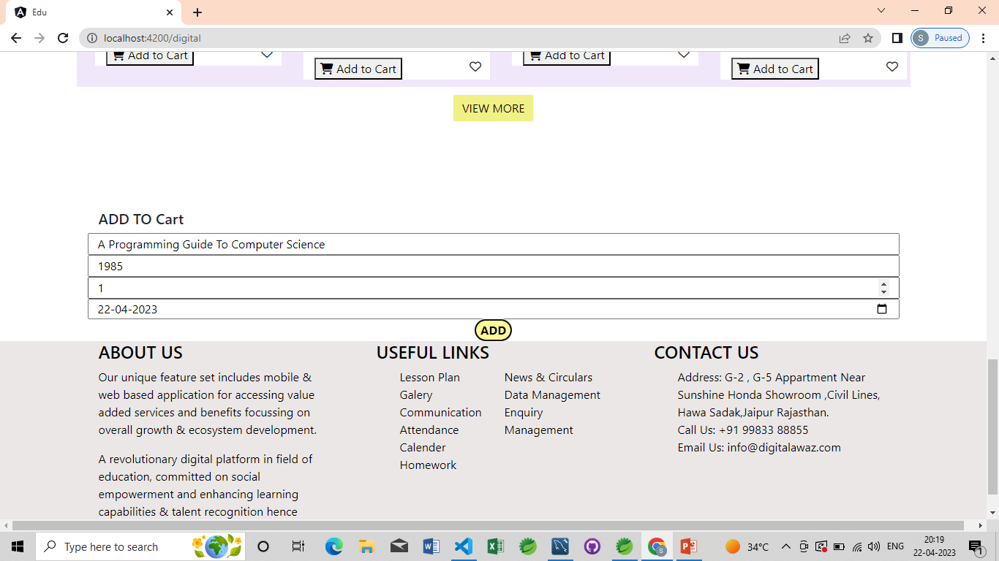
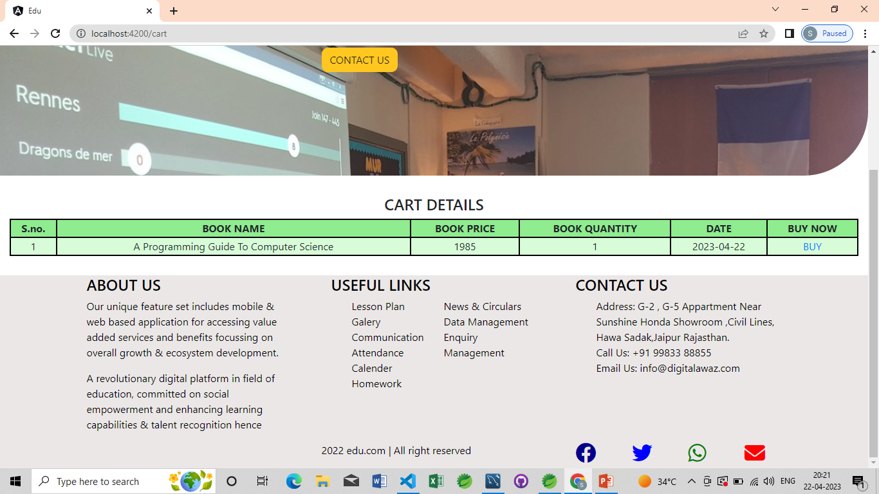

Slide 7
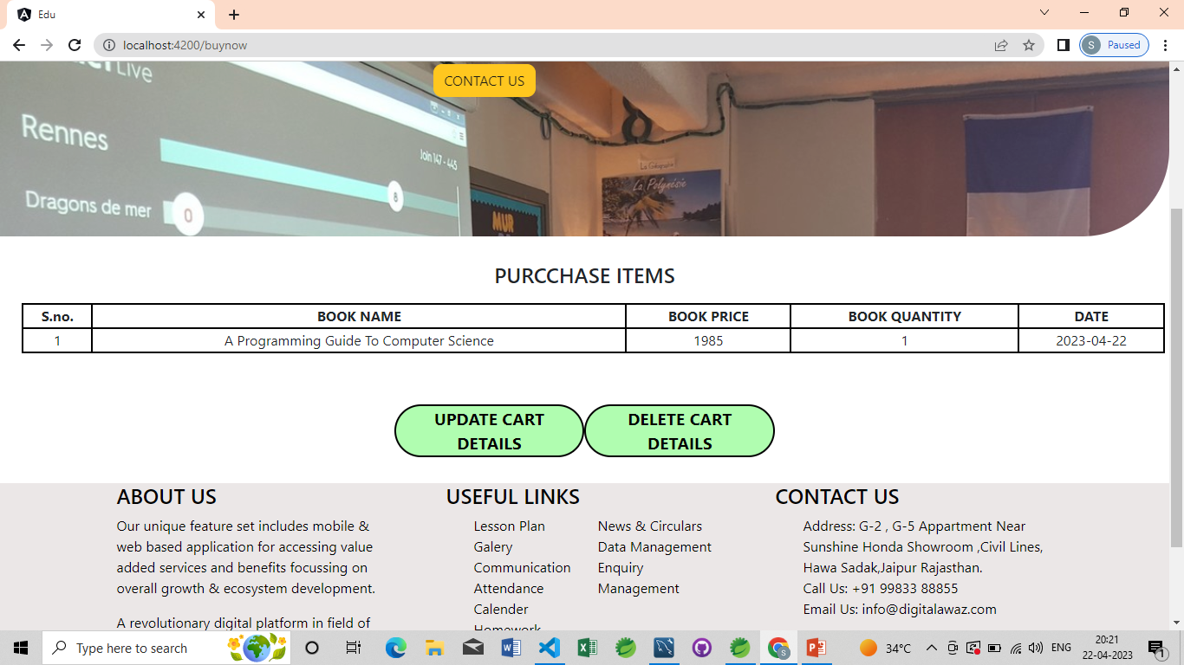
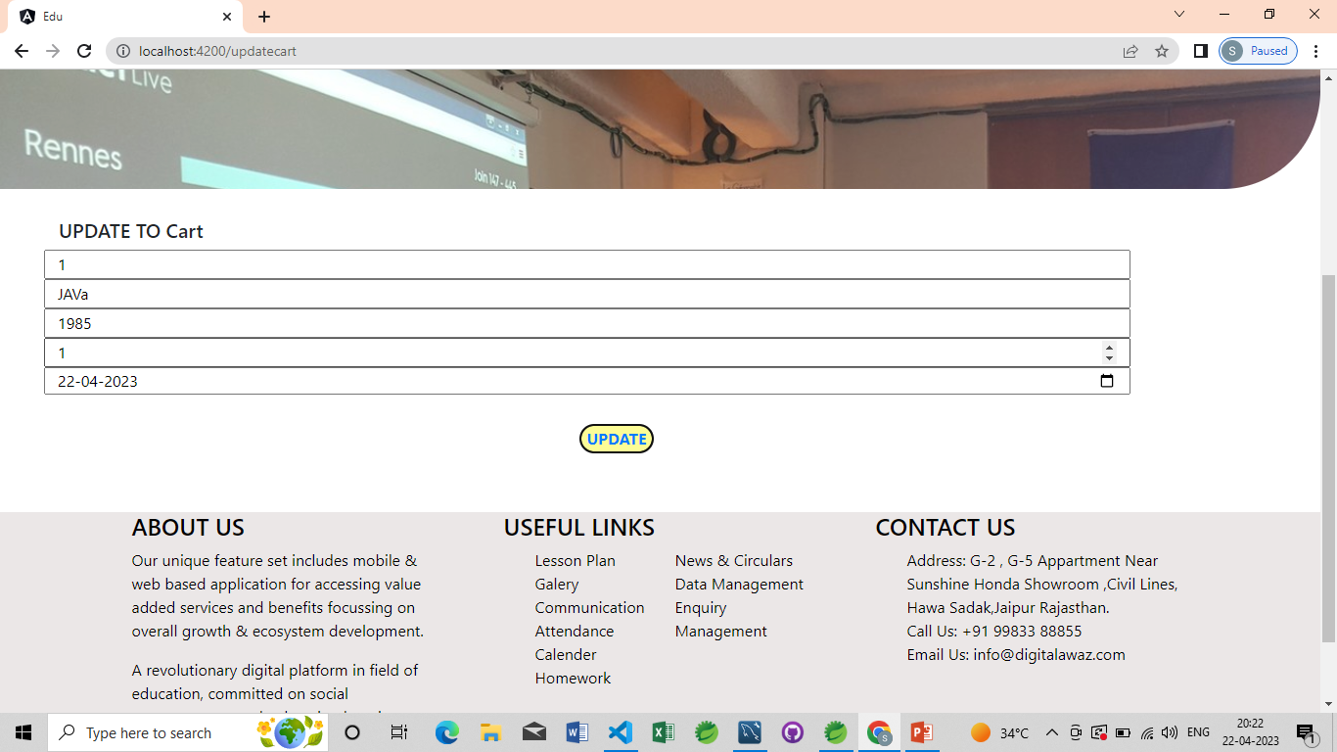
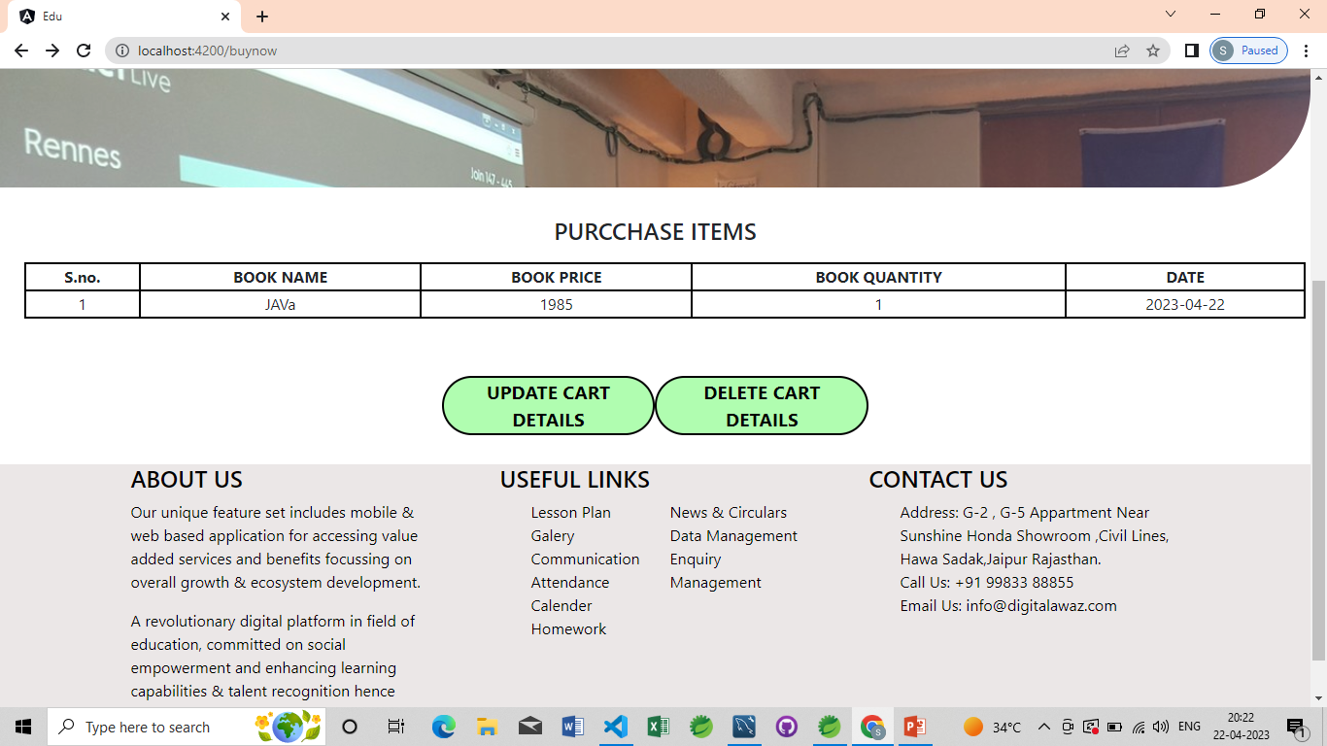
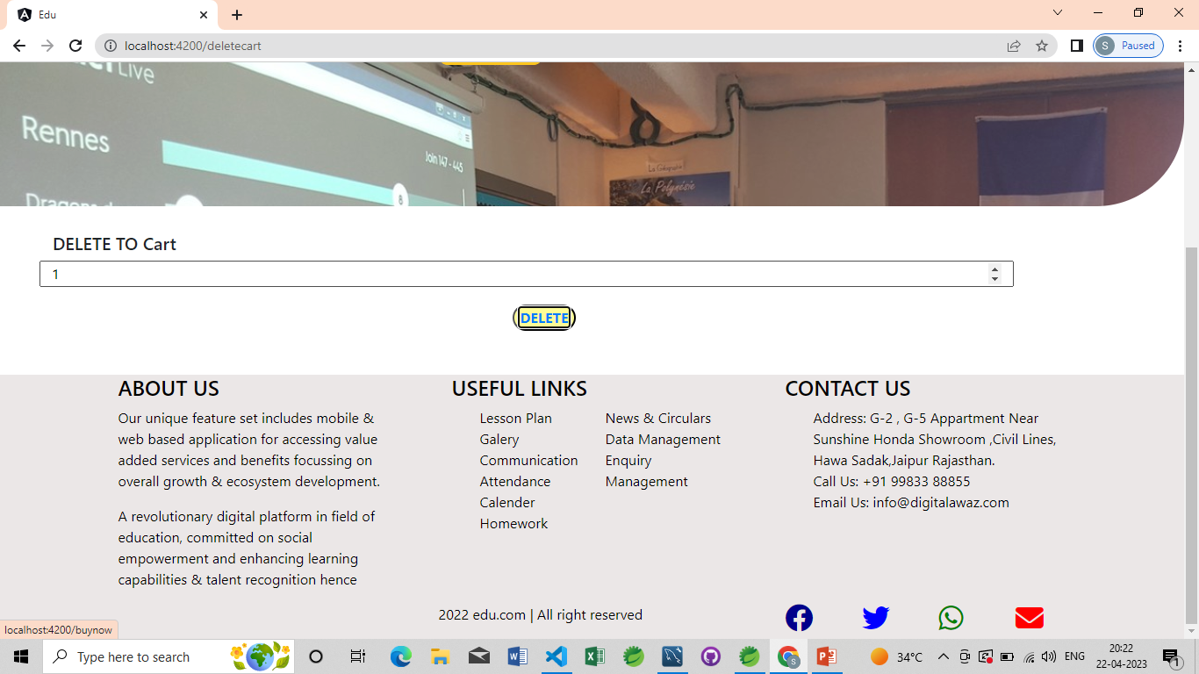

Slide 8
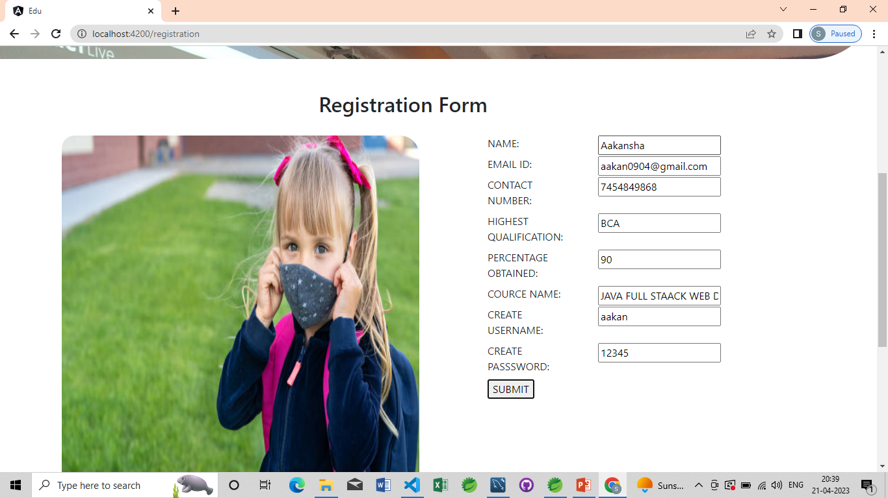
Student registration form

Slide 9
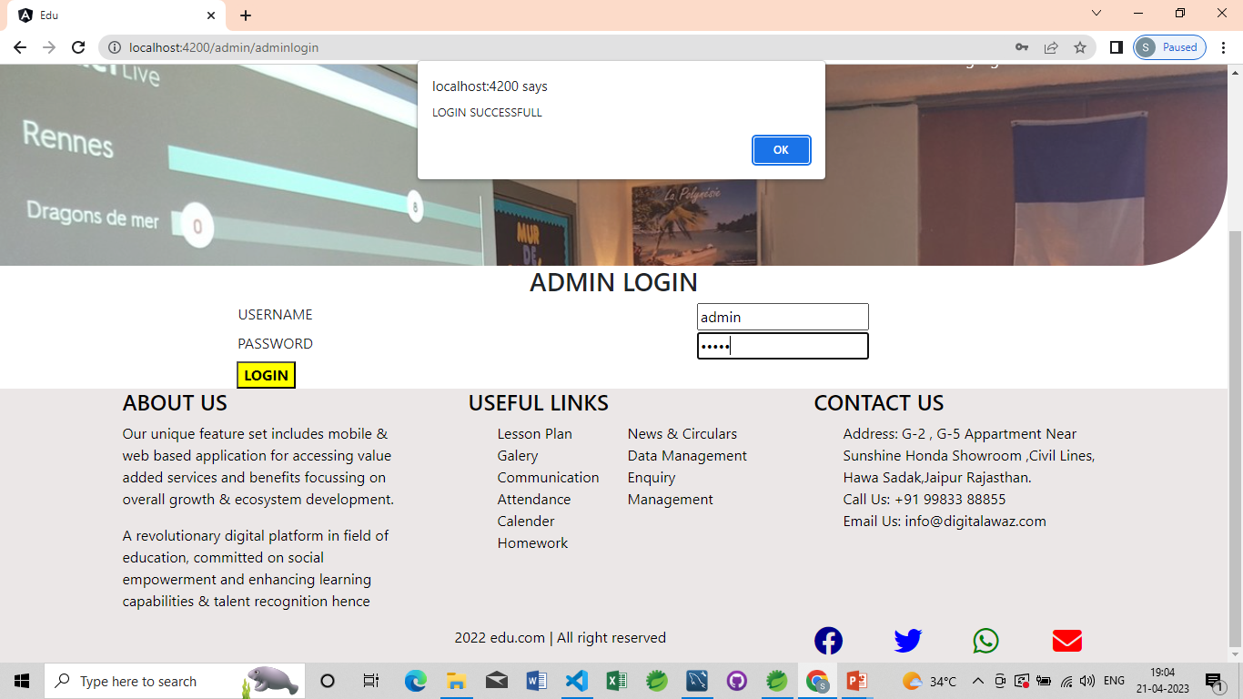
Admin Login

Slide 10
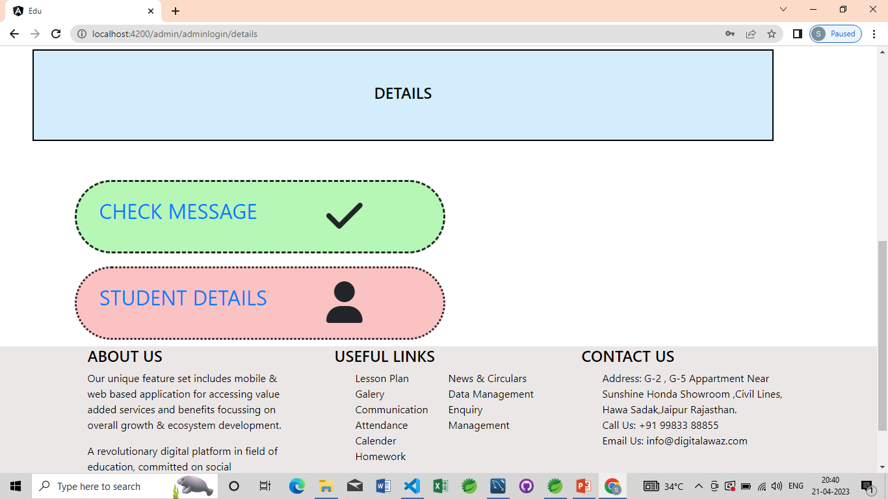

Slide 11
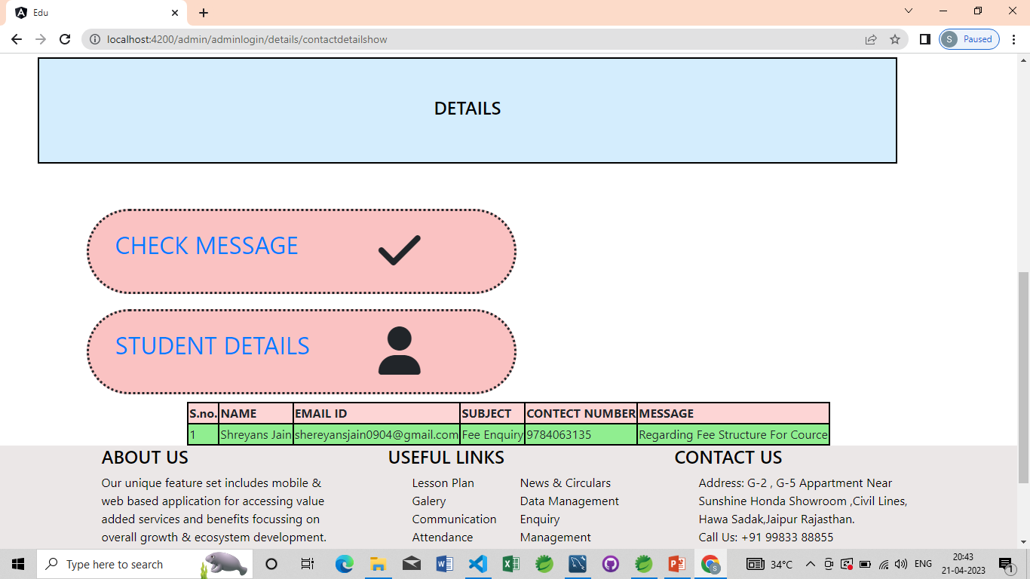

Slide 12
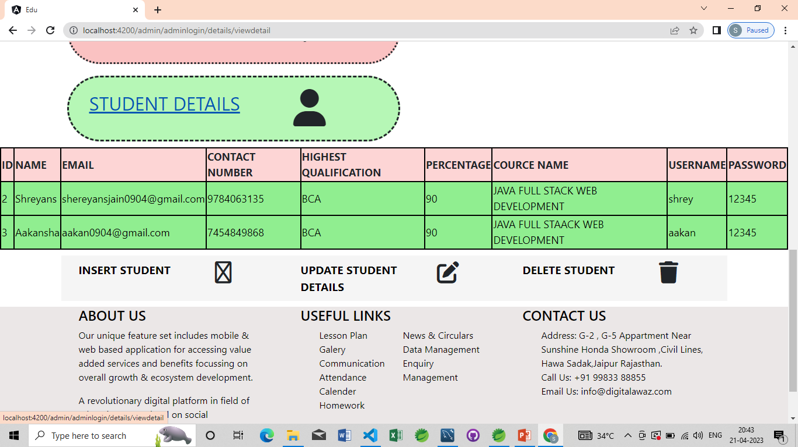

Slide 13
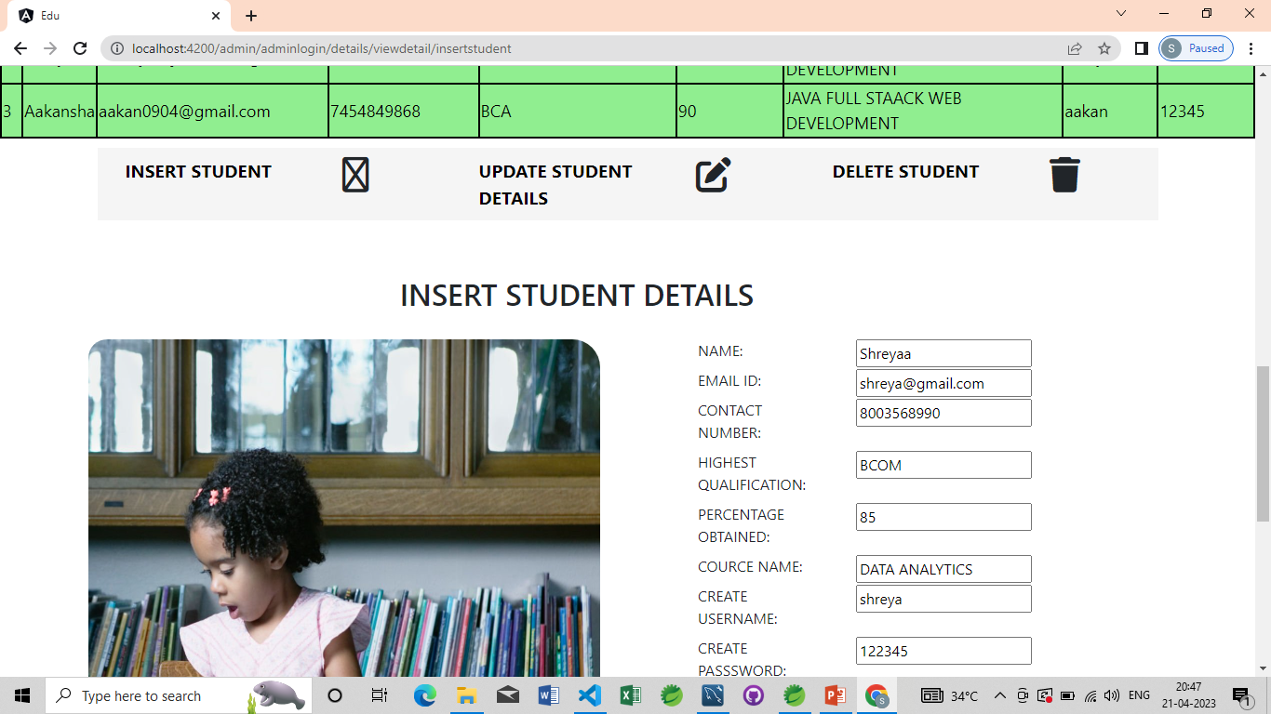

Slide 14
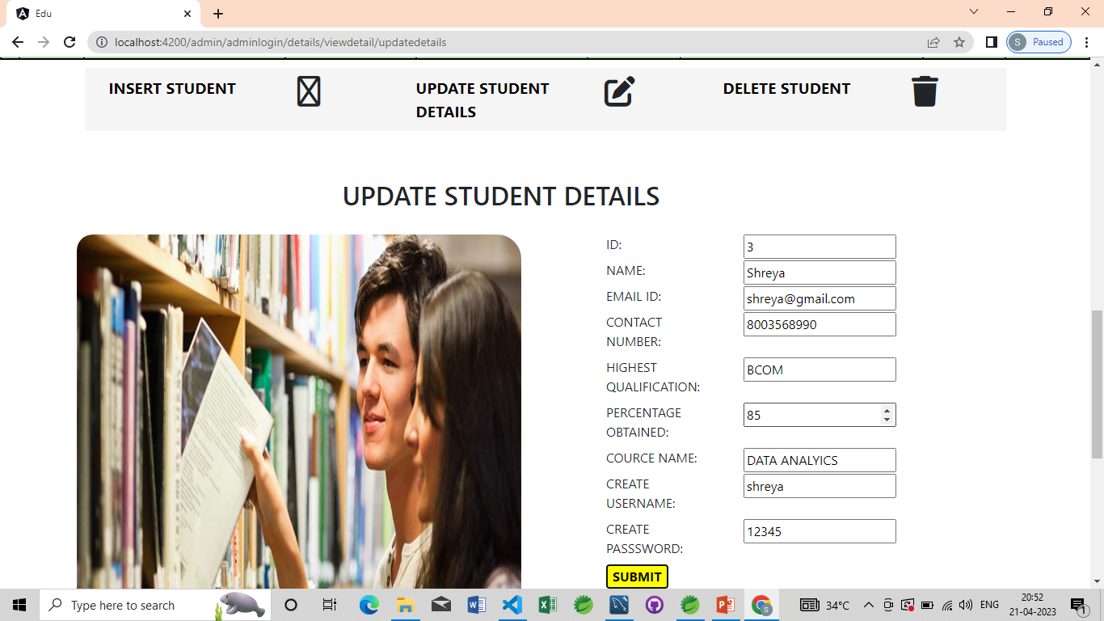

Slide 15
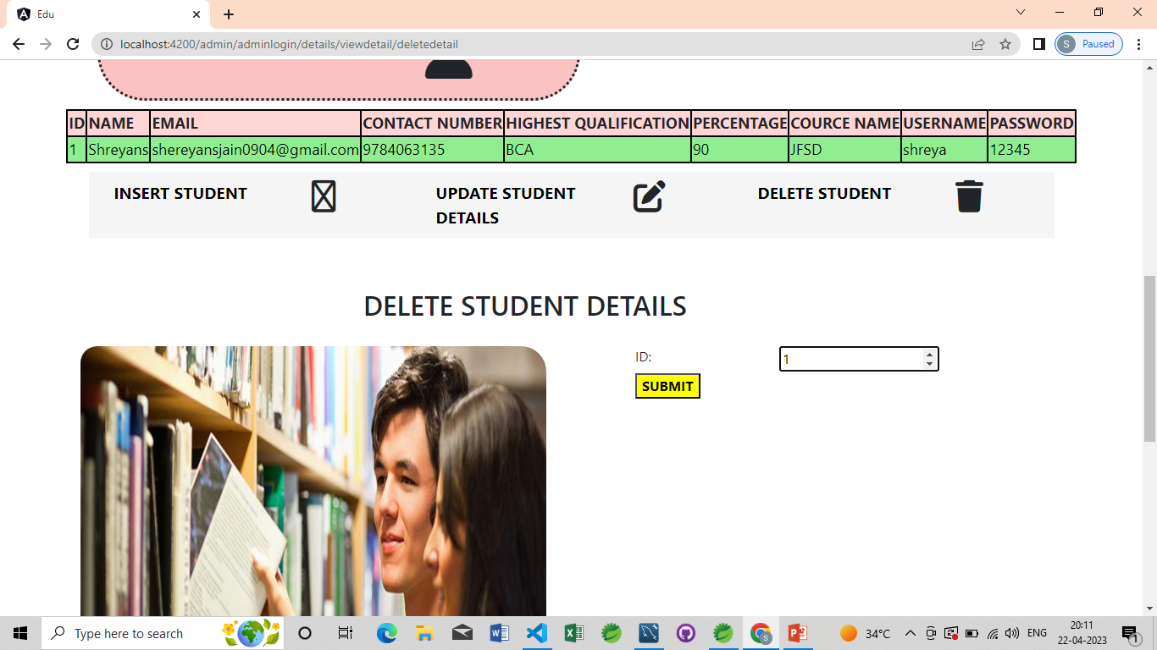

Slide 16
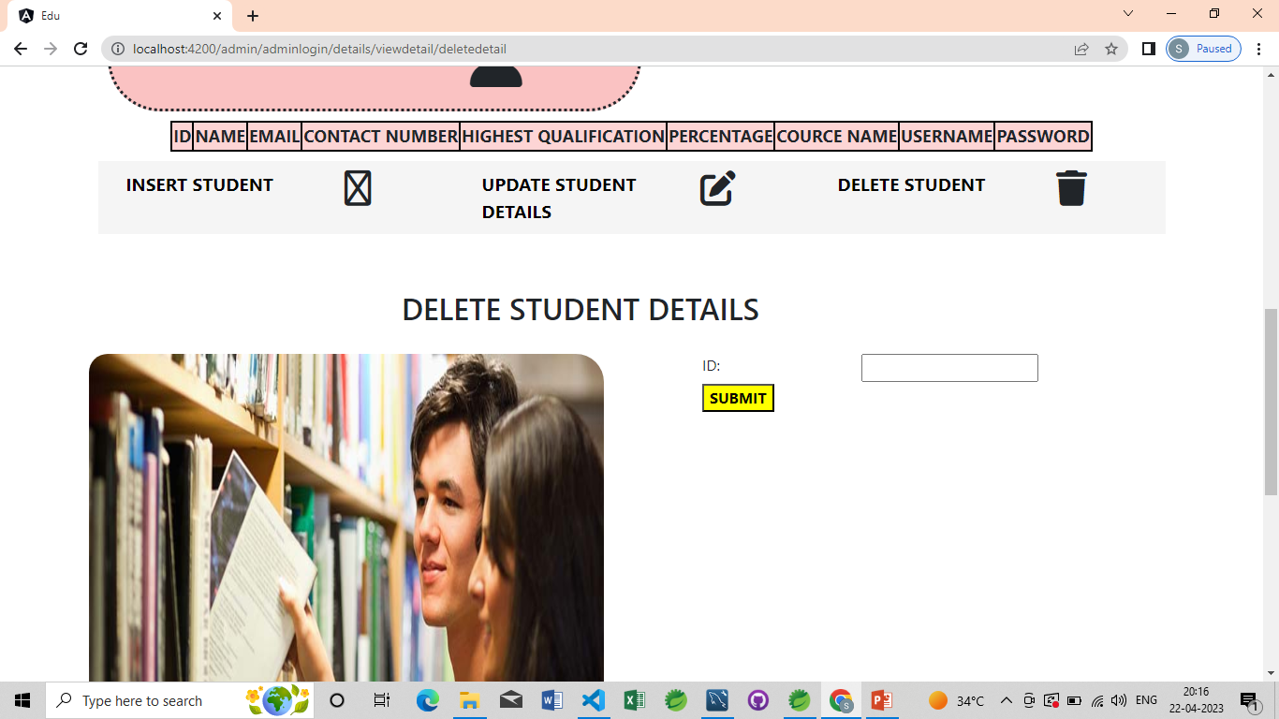

Slide 17
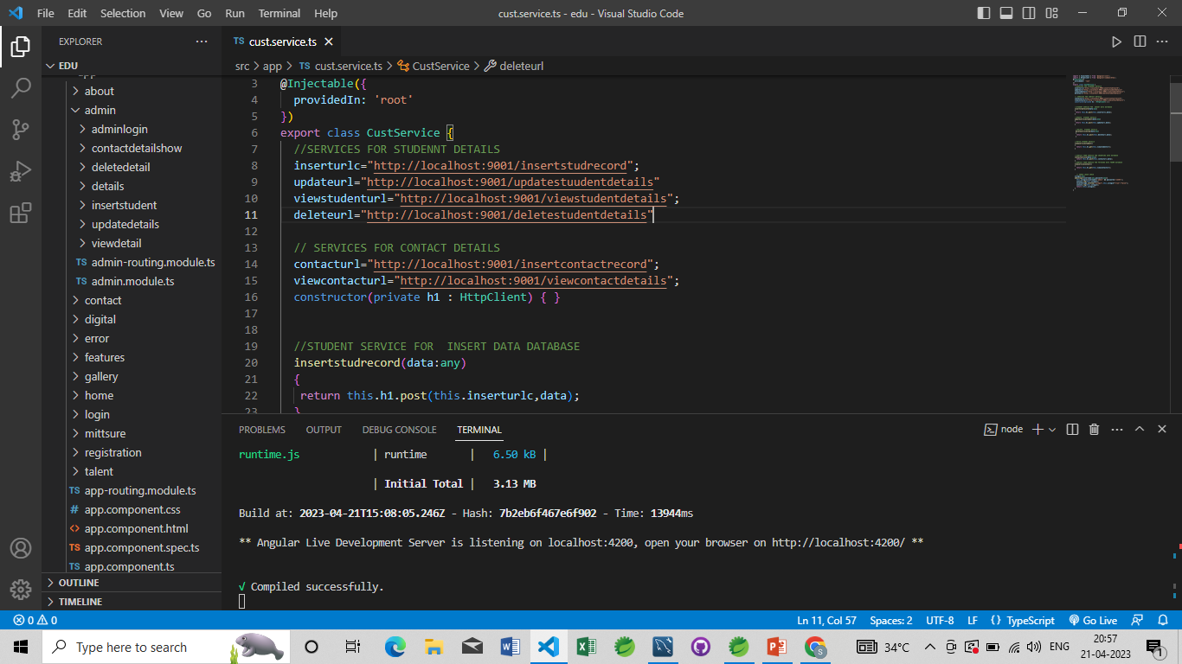
SERVICES IN ANGULAR service file

Slide 18
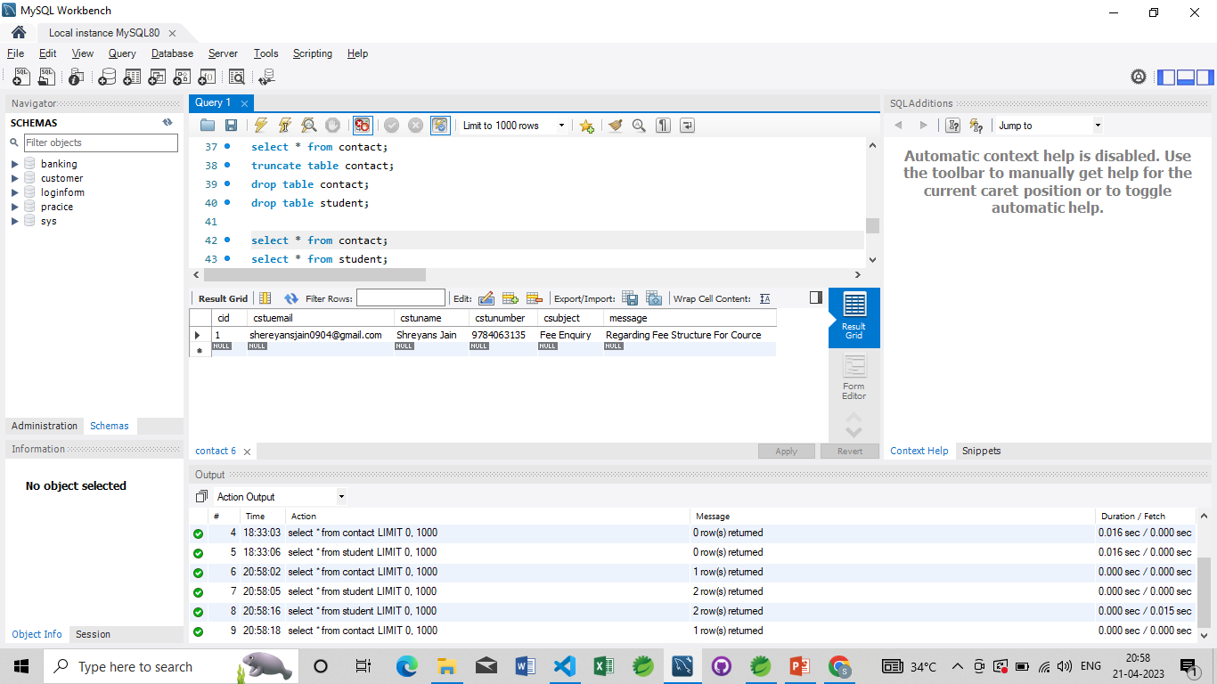
DATABASE

Slide 19
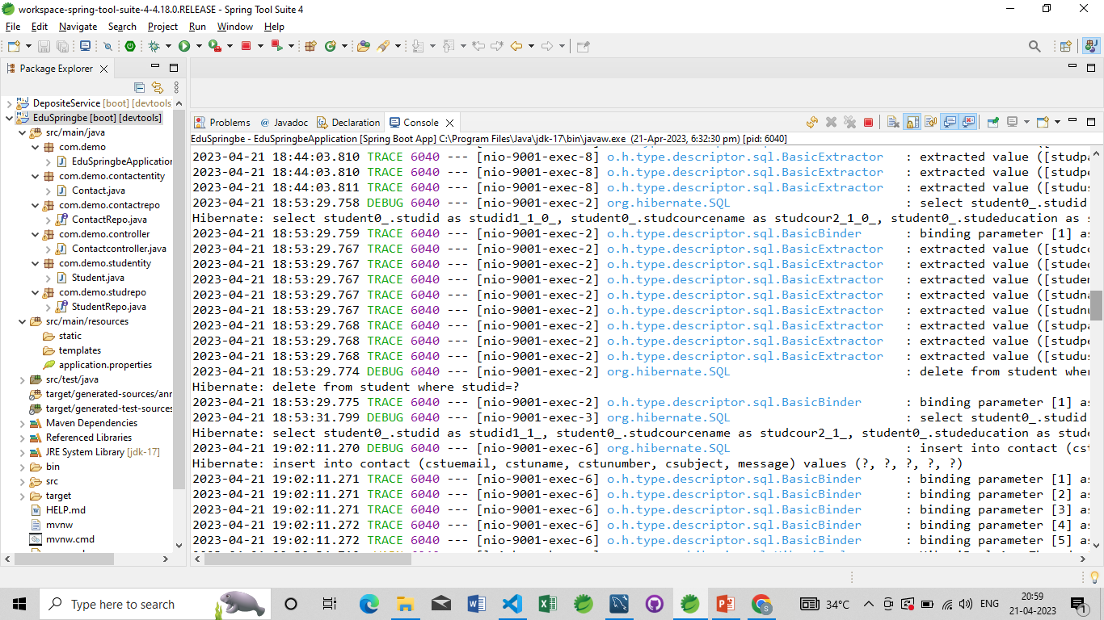
REST CONTROLLER
STS

Slide 20


The student web application is designed to simplify the process of managing student information. It provides an intuitive interface that allows administrators to easily add, view, update, and delete student records. Additionally, the application features a set of REST APIs that allow other applications to interact with the student data. This makes it possible to integrate the student information into other systems and processes, enhancing the overall efficiency and accuracy of the institution's operations. Whether you are a teacher, school administrator, or student, this web application will make it easier to manage and access student information.

Slide 21


The future scope for adding a payment gateway to buy online courses and books in a student web application can be quite significant. Here are a few potential benefits:
Increased revenue: By adding a payment gateway, the application can generate revenue from the sale of online courses and books. This can help the institution to invest in further improvements to the application or to offer more resources to students.
Convenience: Allowing students to purchase courses and books directly through the application can be more convenient than having them navigate to other sites to make purchases.
Improved data management: By integrating payment information directly into the application, administrators can more easily track purchases and manage financial data.
Expansion opportunities: Adding a payment gateway can provide opportunities to expand the application's offerings beyond just courses and books. For example, the application could offer additional services or products that students may find useful
Overall, adding a payment gateway to a student web application can help to increase revenue, convenience, and data management capabilities, while also providing opportunities for expansion and growth.

Slide 22
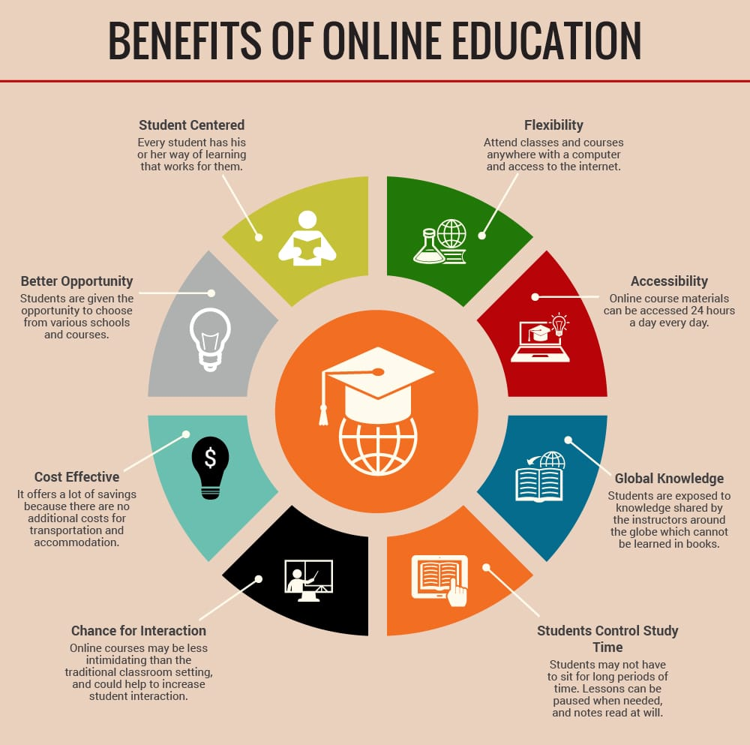

Slide 23

THANK YOU
OUR DEGREE YOUR FUTURE

